Slide 1



ATLAS
INDONESIA
ANDROID MIGRATION TO JETPACK COMPOSE
com.reefii.atlasindonesia*compose*
ARIF PURNOMO AJI . REEFII
DICODING
Compose Champion Indonesia 2023:
Compose Migration Champion Challenge

Slide 2
Atlas Indonesia
Application that contains 5 major islands and 34 maps of Indonesian provinces based on books from the Indonesian Geospatial Information Agency.

Slide 3

JETPACK
COMPOSE
Jetpack Compose is Android’s recommended modern toolkit for building native UI. It simplifies and accelerates UI development on Android. Quickly bring your app to life with less code, powerful tools, and intuitive Kotlin APIs.

Slide 4
Atlas Indonesia Activity
Splash
Settings
splash screen
settings area
Detail View
Main
Activity
Source
detailed description with the map
Regions list of Indonesia with recyclerview
show library resource
Zoom View
About
view feature for map zoom
about application & developer

Slide 5
Atlas Indonesia Migration Plan
Data
Settings
Initiate data list from Recycler to lazylist (Array to Data Provider)
synchronize theme & app localization
UI
Code Sinc
Clearing
Recreate UI from XML to Jetpack Composable UI
synchronize code handler with composable UI
Remove old XML layout & unused code

Slide 6
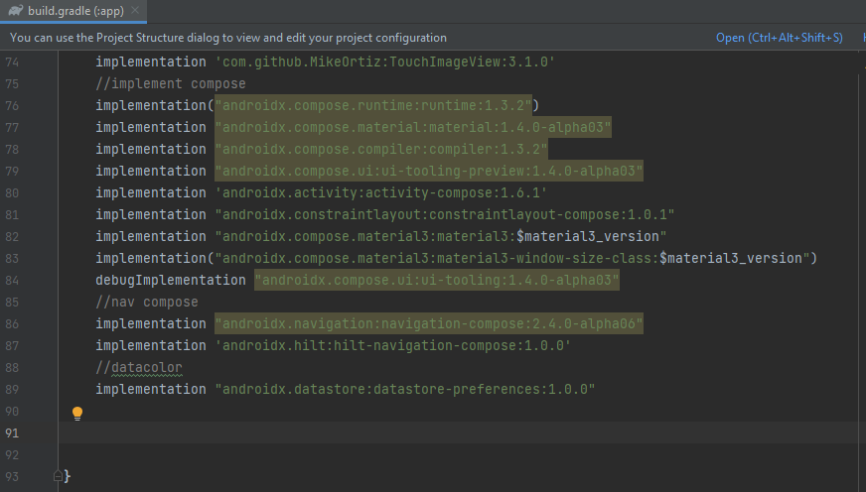
Compose Migrate Preparation
Add Jetpack Compose component Implementation in build.gradle (App Level)

Slide 7
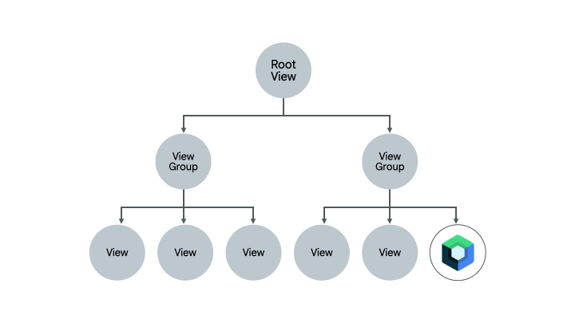
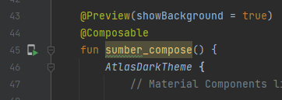
XML UI to Compose UI
Recreate XML Based UI to Jetpack Compose UI with @Composable function.
Migrate from the outermost view to the root / Mainactivity

Slide 8
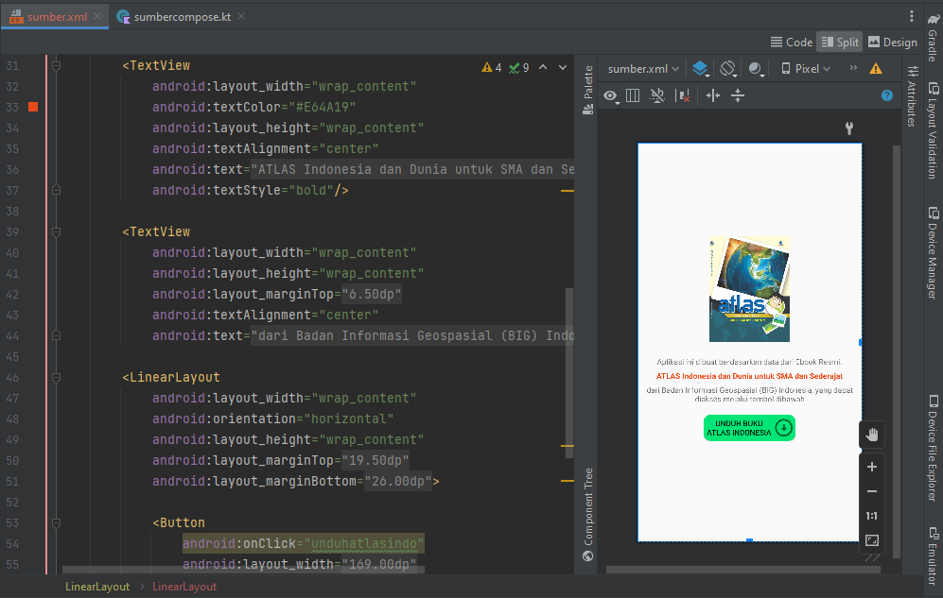
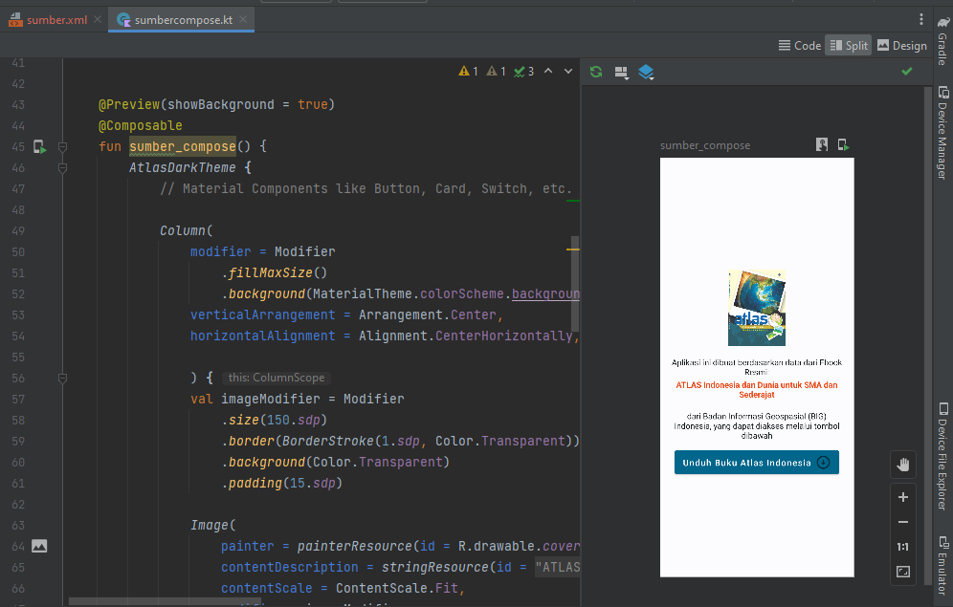
Sumber UI Migration
sumber.XML
sumbercompose

Slide 9
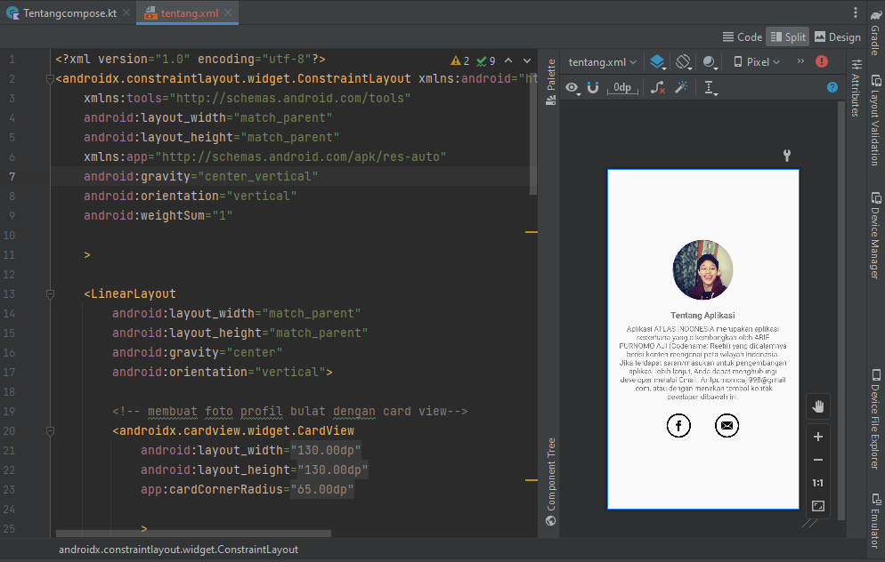
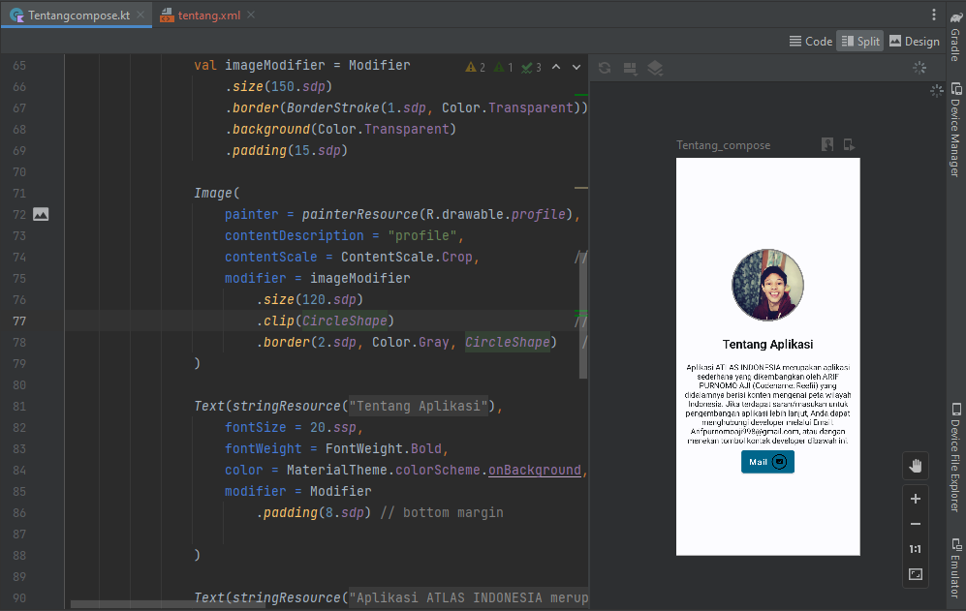
Tentang UI Migration
tentang.XML
Tentangcompose

Slide 10
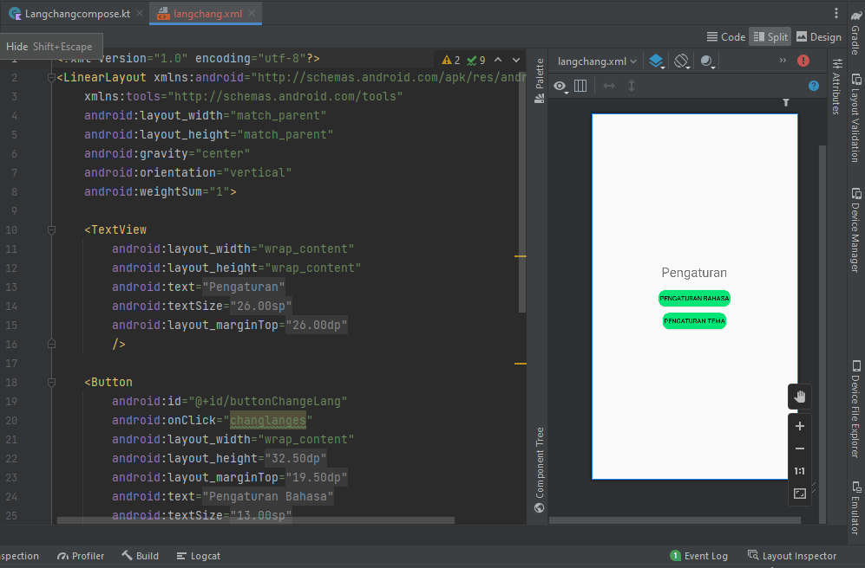
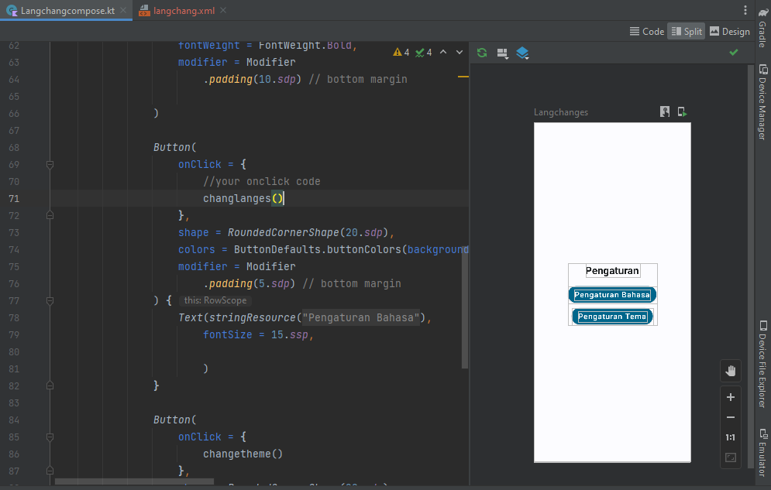
Settings UI Migration
langchang.XML
Langchangcompose

Slide 11
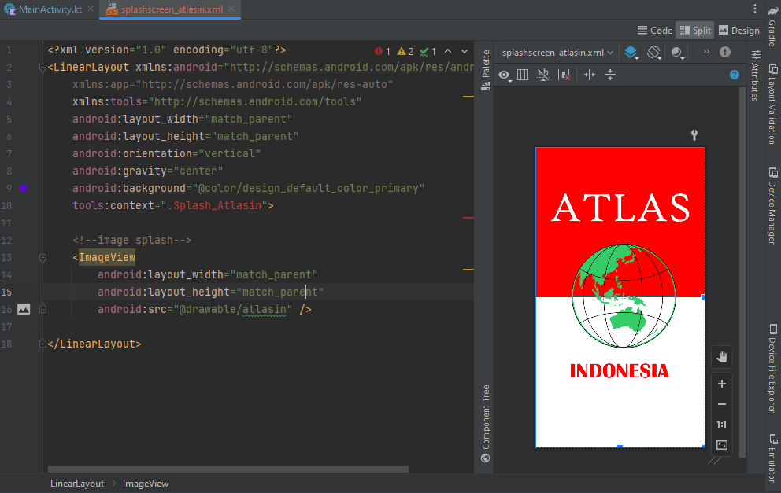
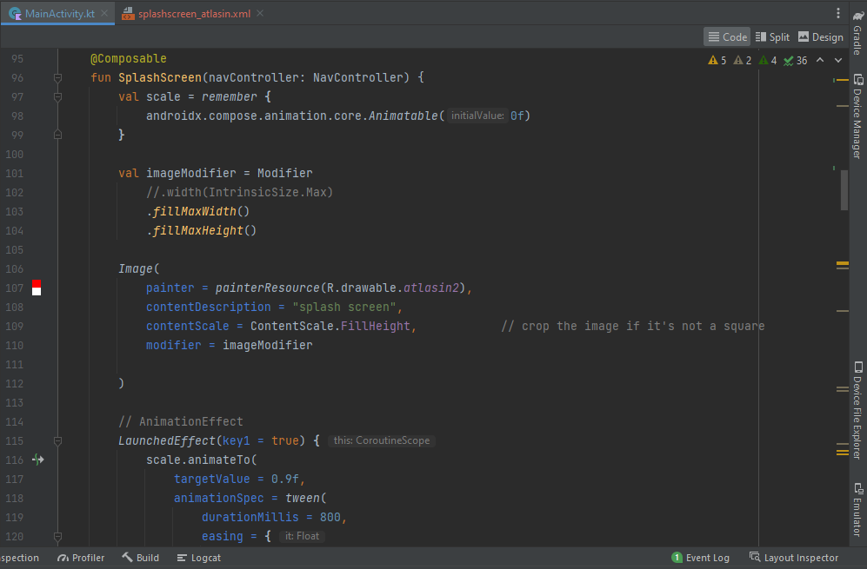
Splash UI Migration
splashscreen_ Atlasin.XML
MainActivity (Animated Splashscreen)

Slide 12
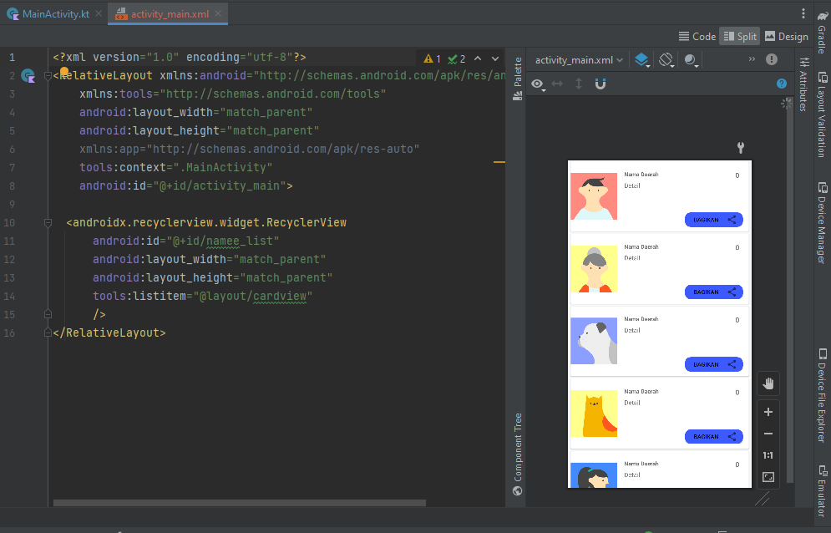
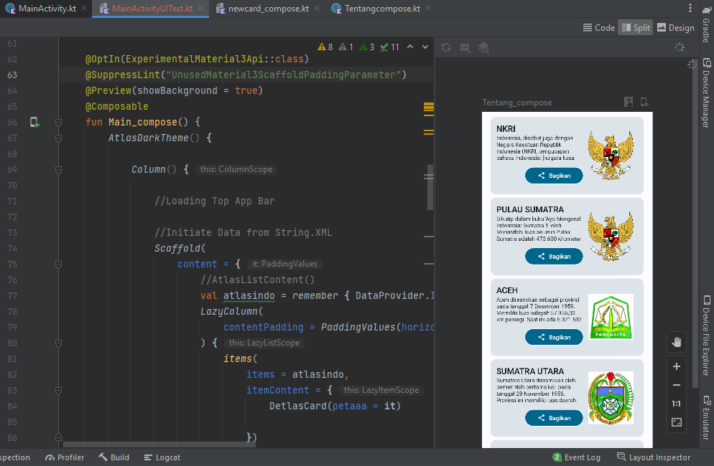
MainActivity UI Migration
activity_main.XML
MainActivity

Slide 13
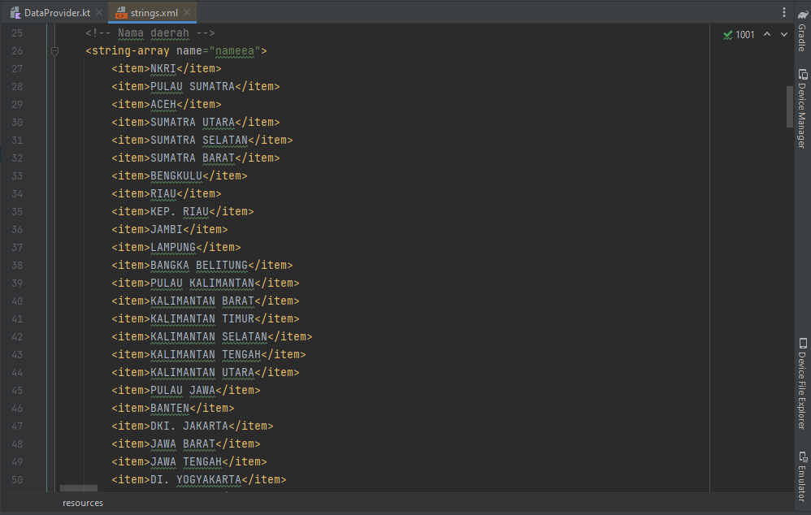
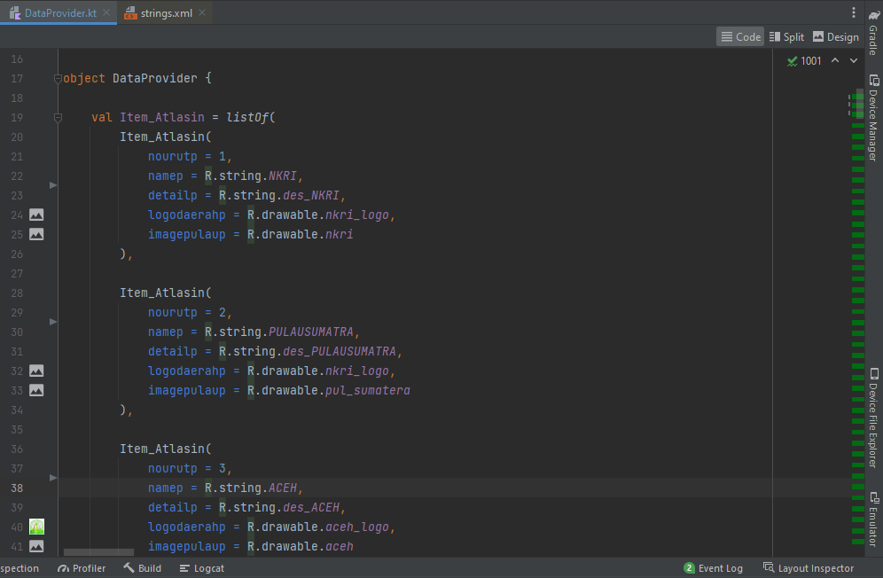
DATA Migration
Data with String Array
Data with object (listOf)

Slide 14
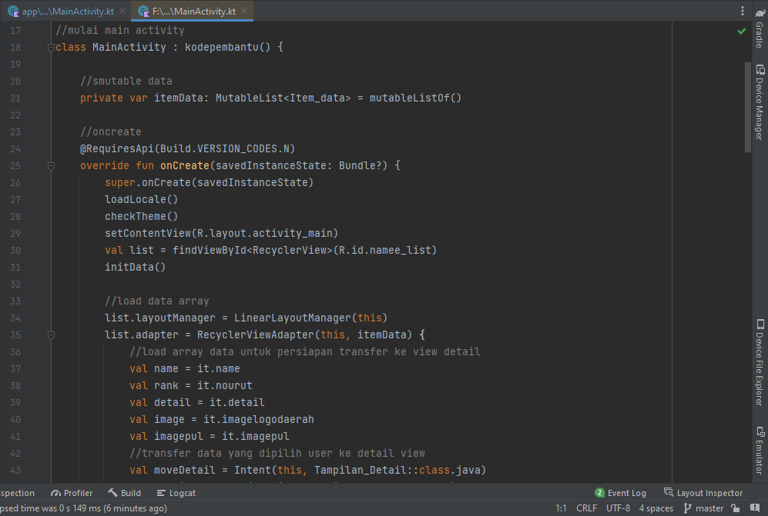
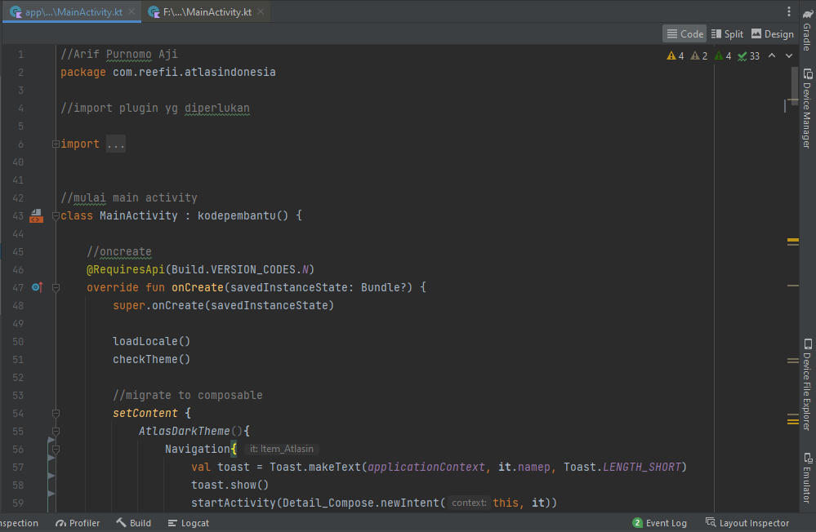
CODE Sync
Code Sync with XML UI
Code Sync with Compose UI

Slide 15
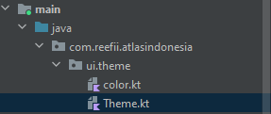
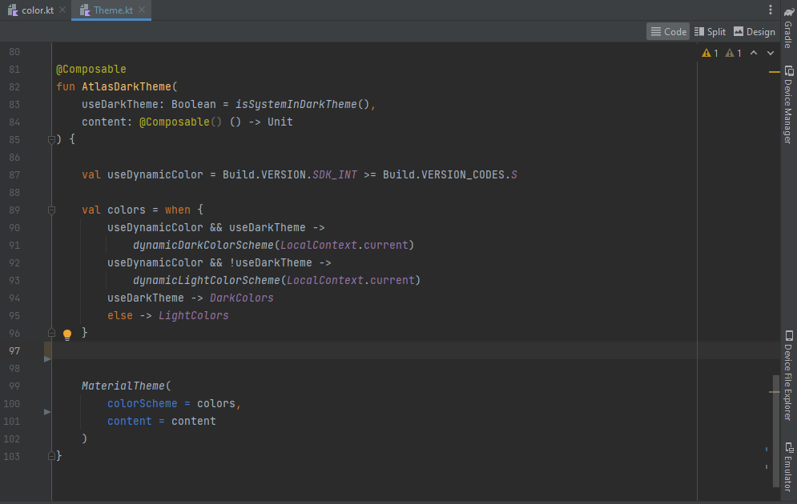
Settings |Theme
ADD New Custom Theme based on Material3 documentation to implement light & dark mode

Slide 16
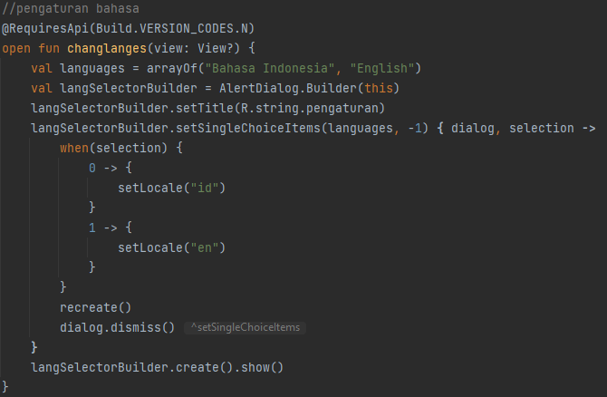
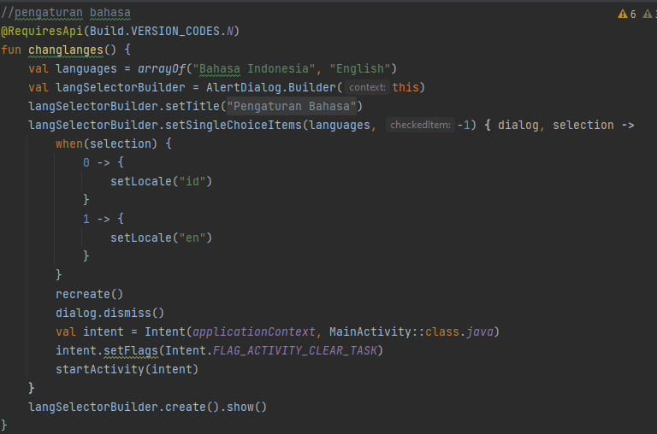
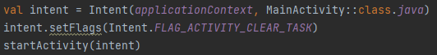
Settings |Language/Locale
ADD Restart to MainActivity function to force Recompose Locale

Slide 17
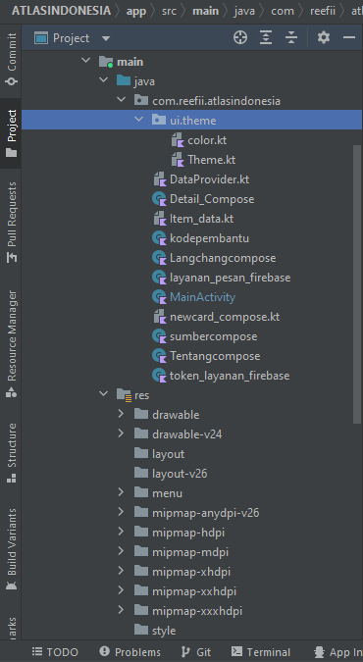
CODE
Clearing
remove unused code, layout xml and kotlin files

Slide 18
Successful Migration to Compose UI?
100%
Compose UI
You can describe the topic of the section here
0%
XML UI
You can describe the topic of the section here

Slide 19

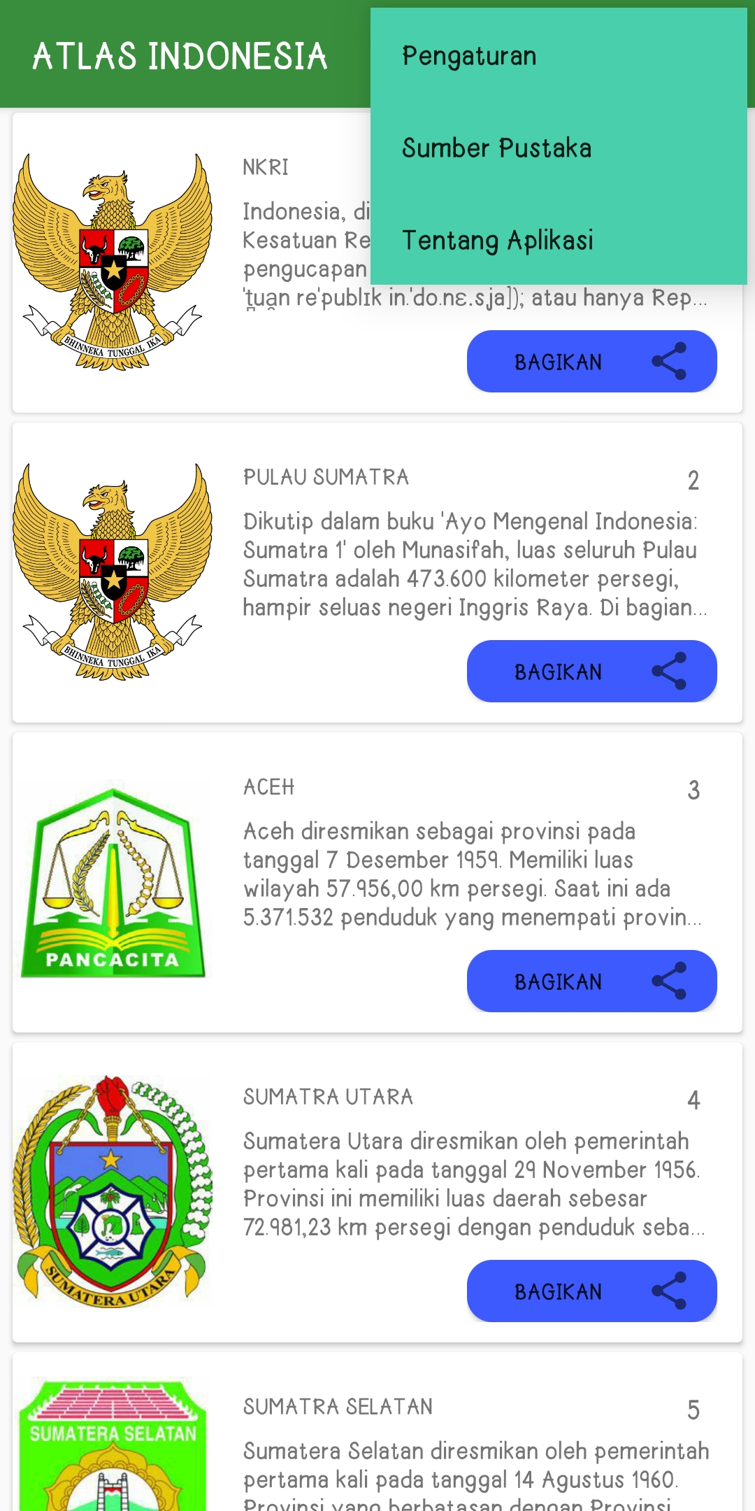
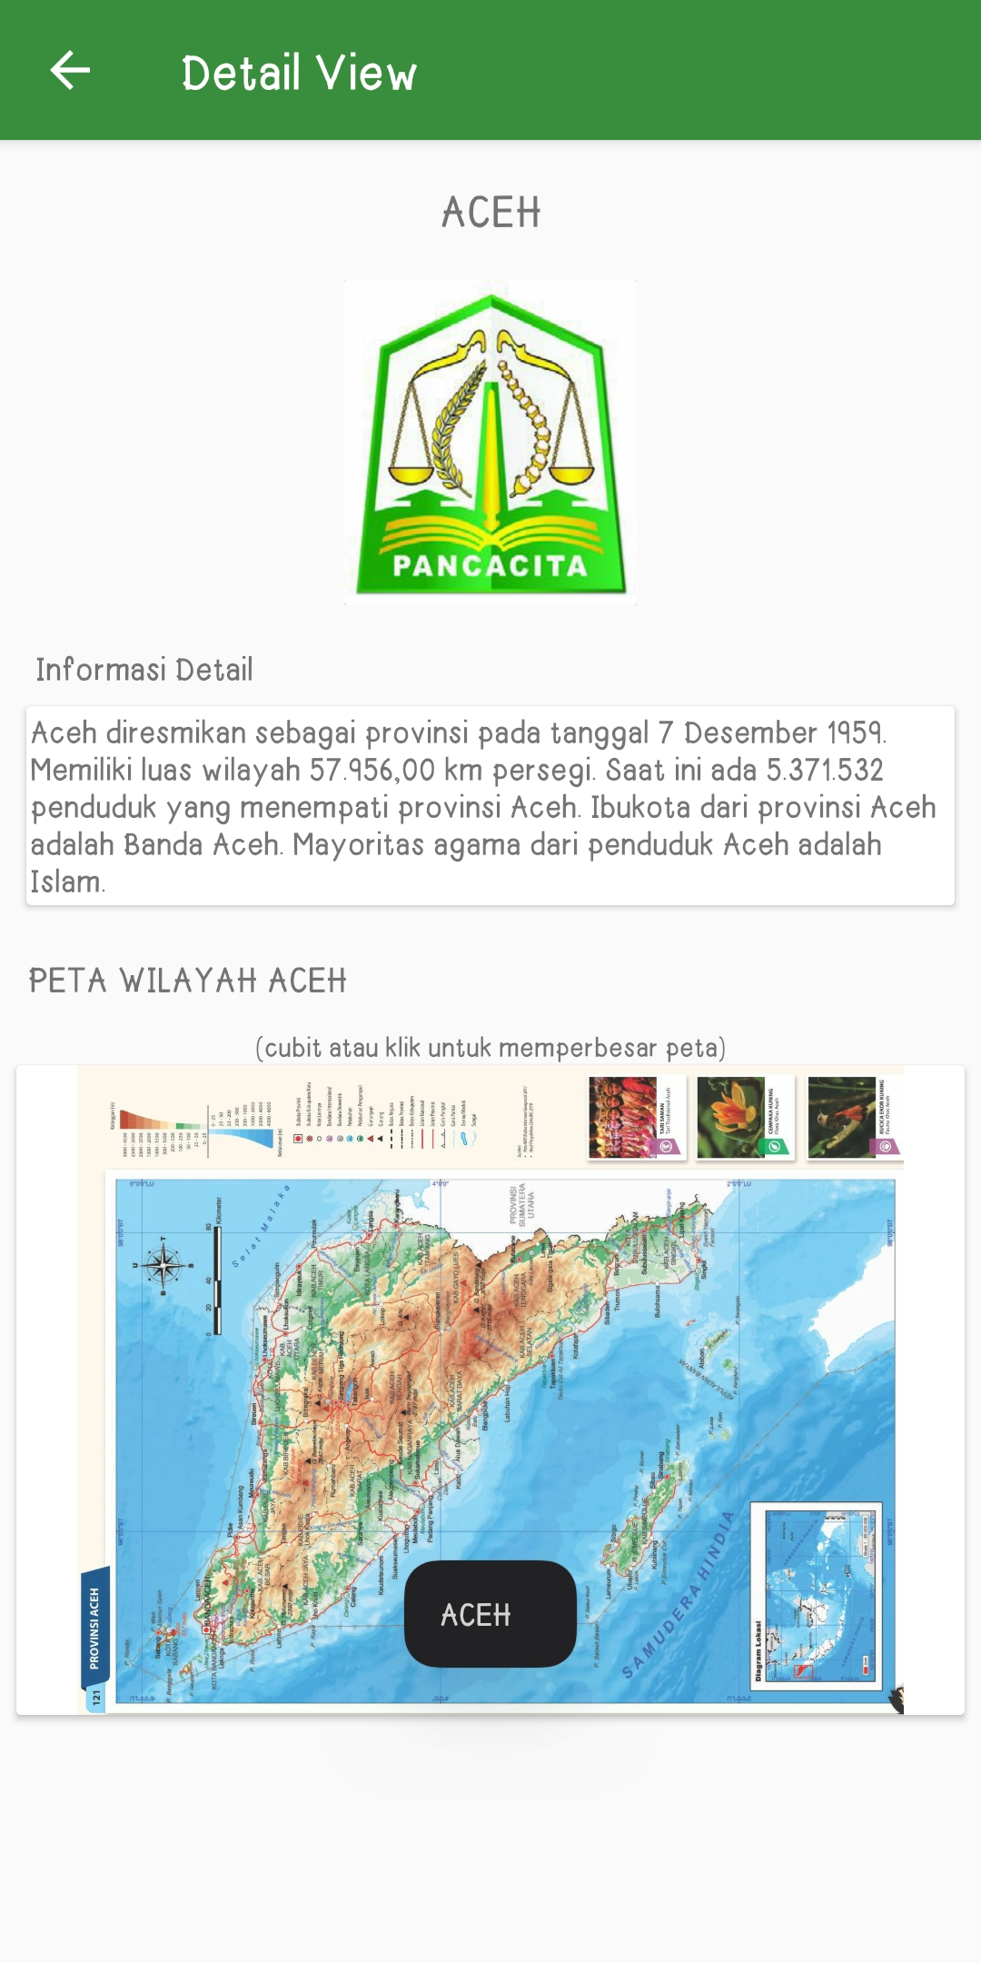
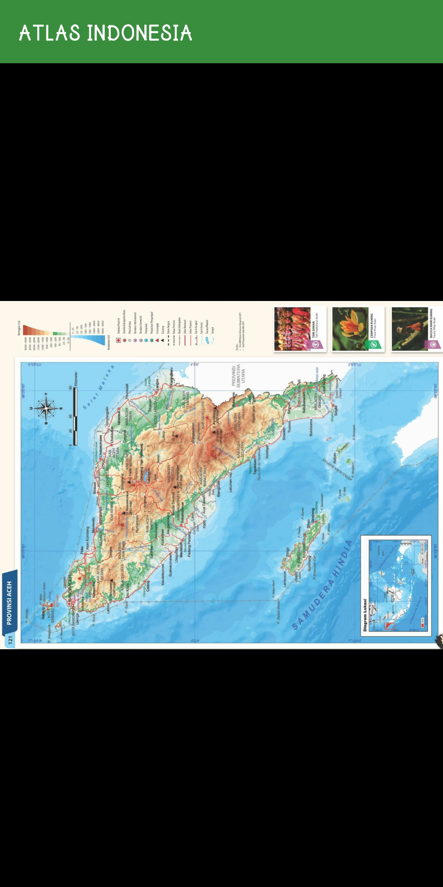
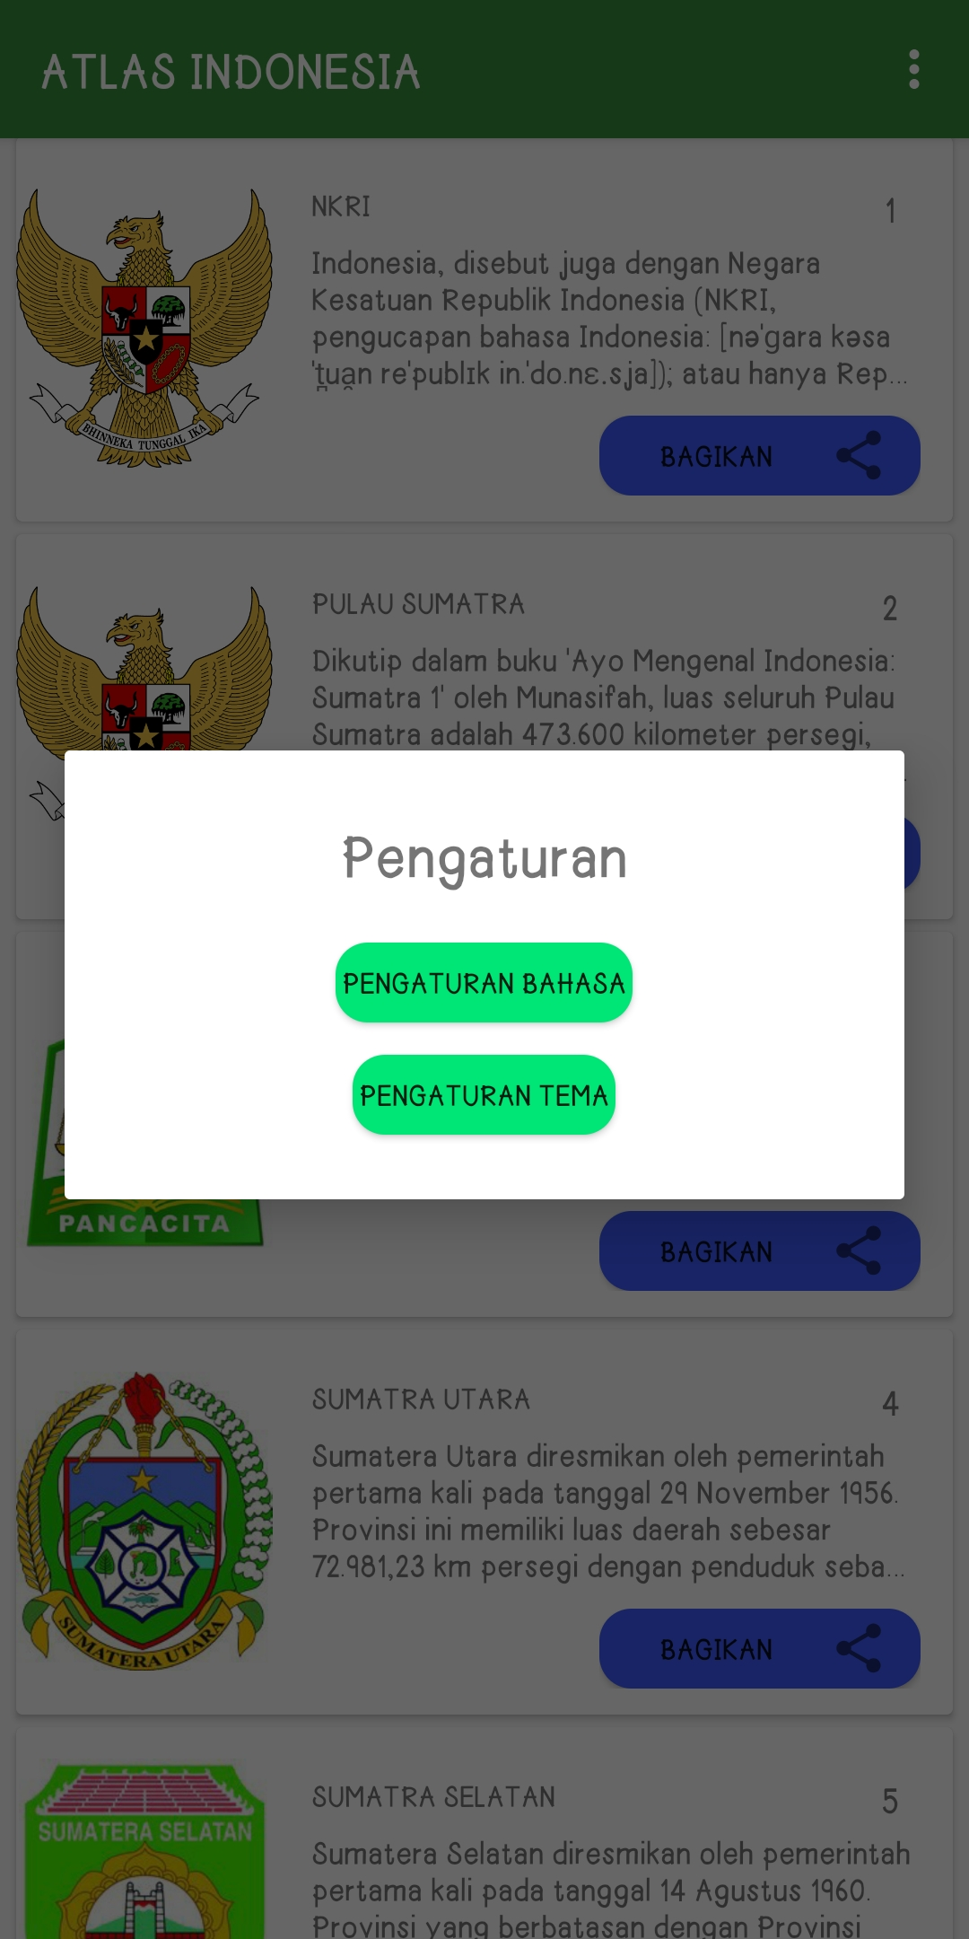
ATLAS INDONESIA SCREEN BEFORE MIGRATE TO COMPOSE UI

Slide 20
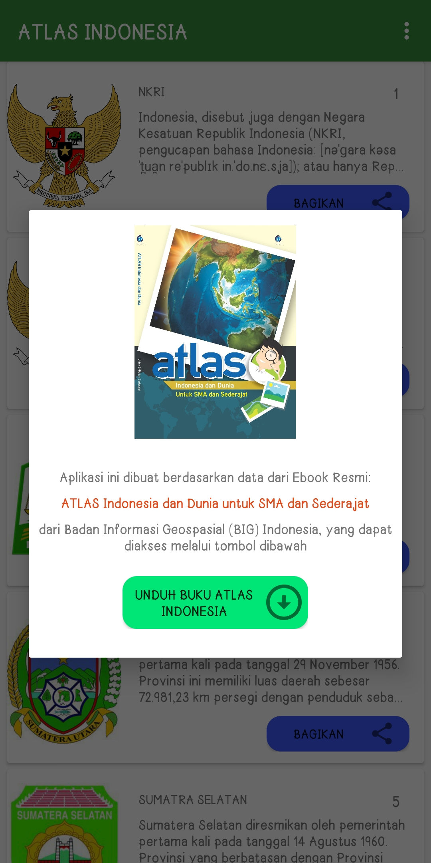
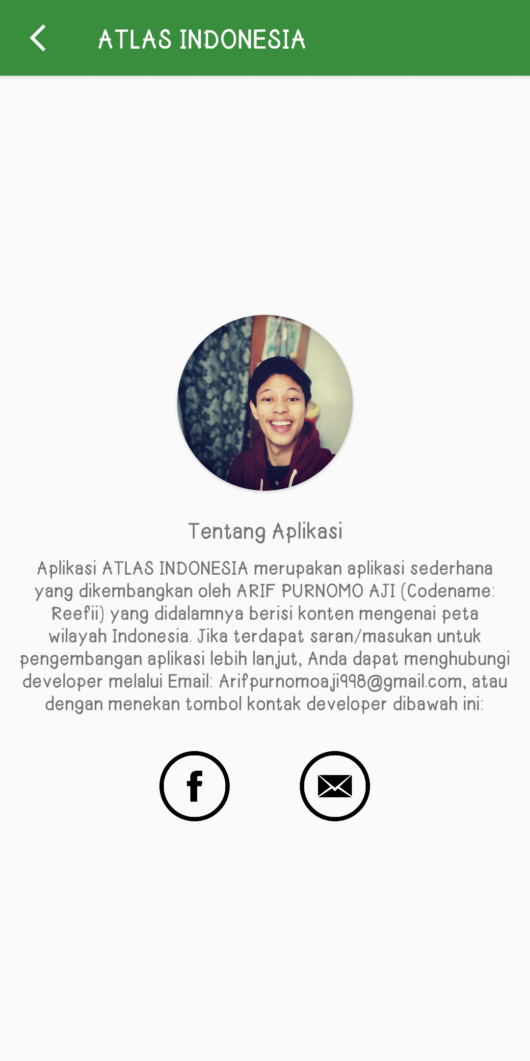
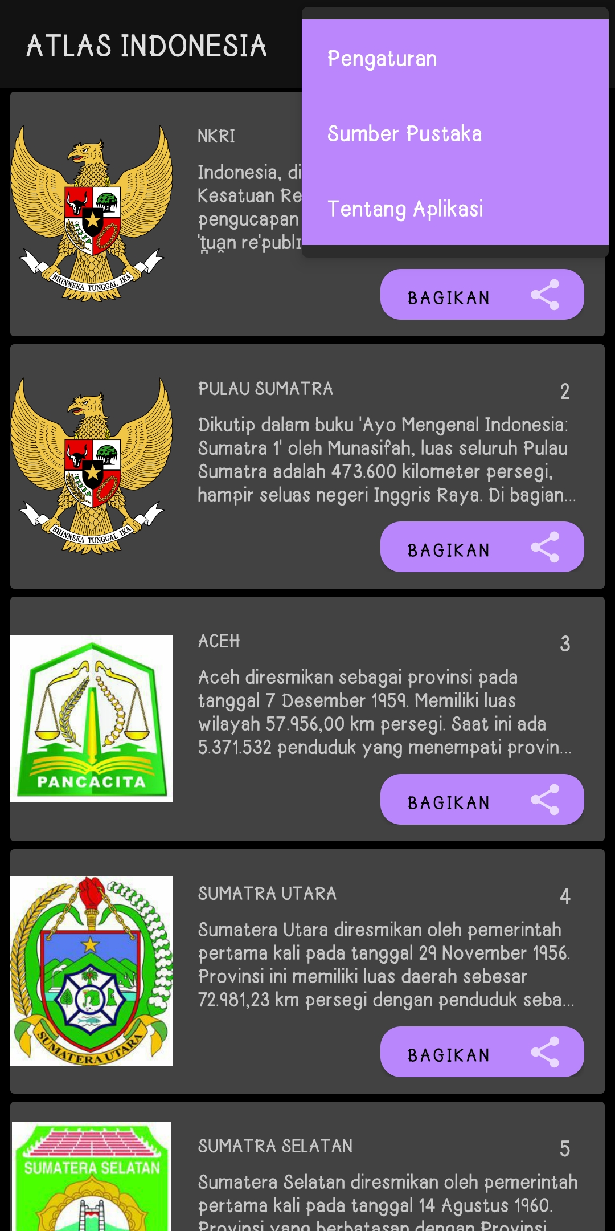
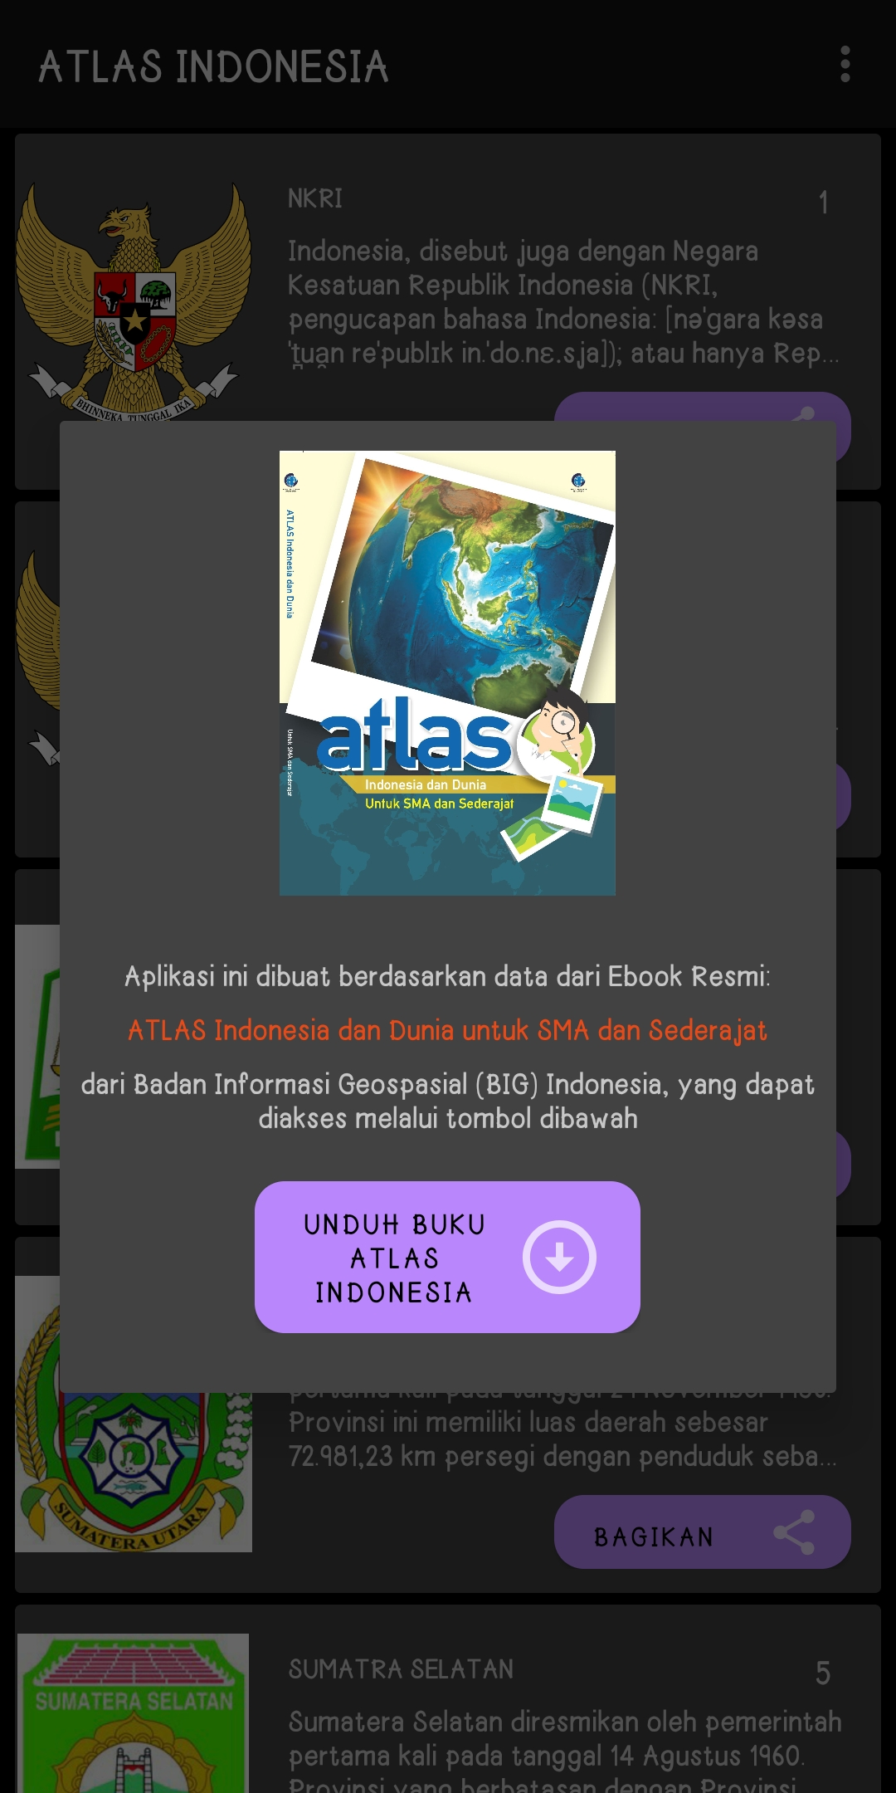
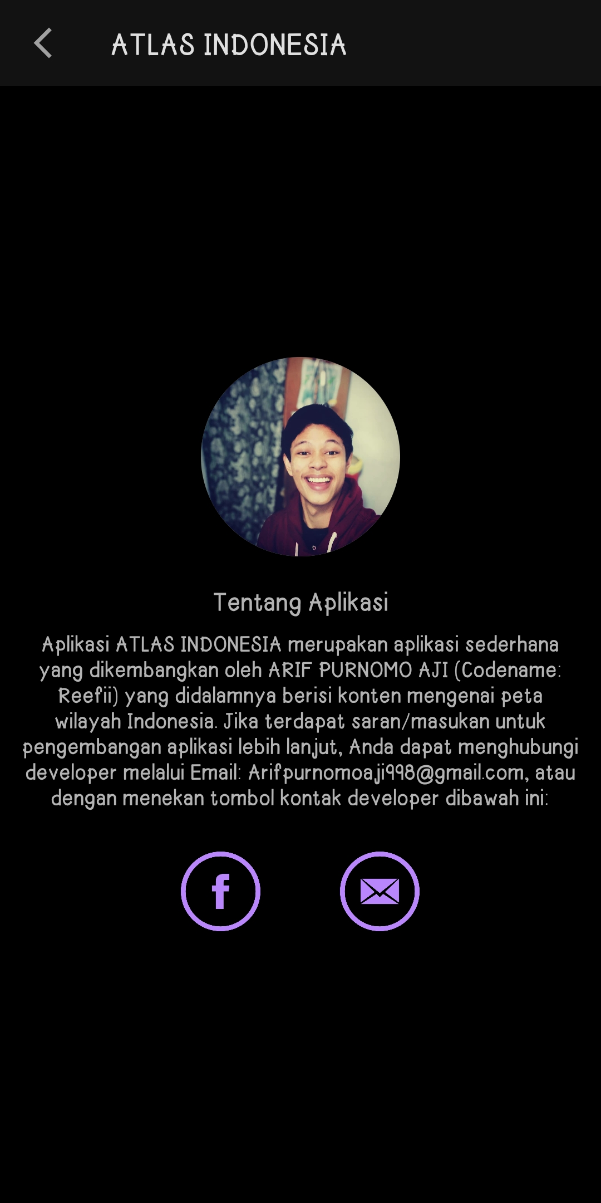
ATLAS INDONESIA SCREEN BEFORE MIGRATE TO COMPOSE UI

Slide 21
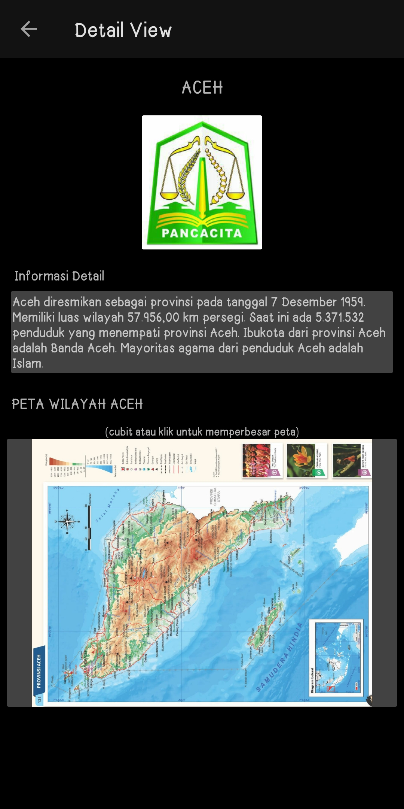
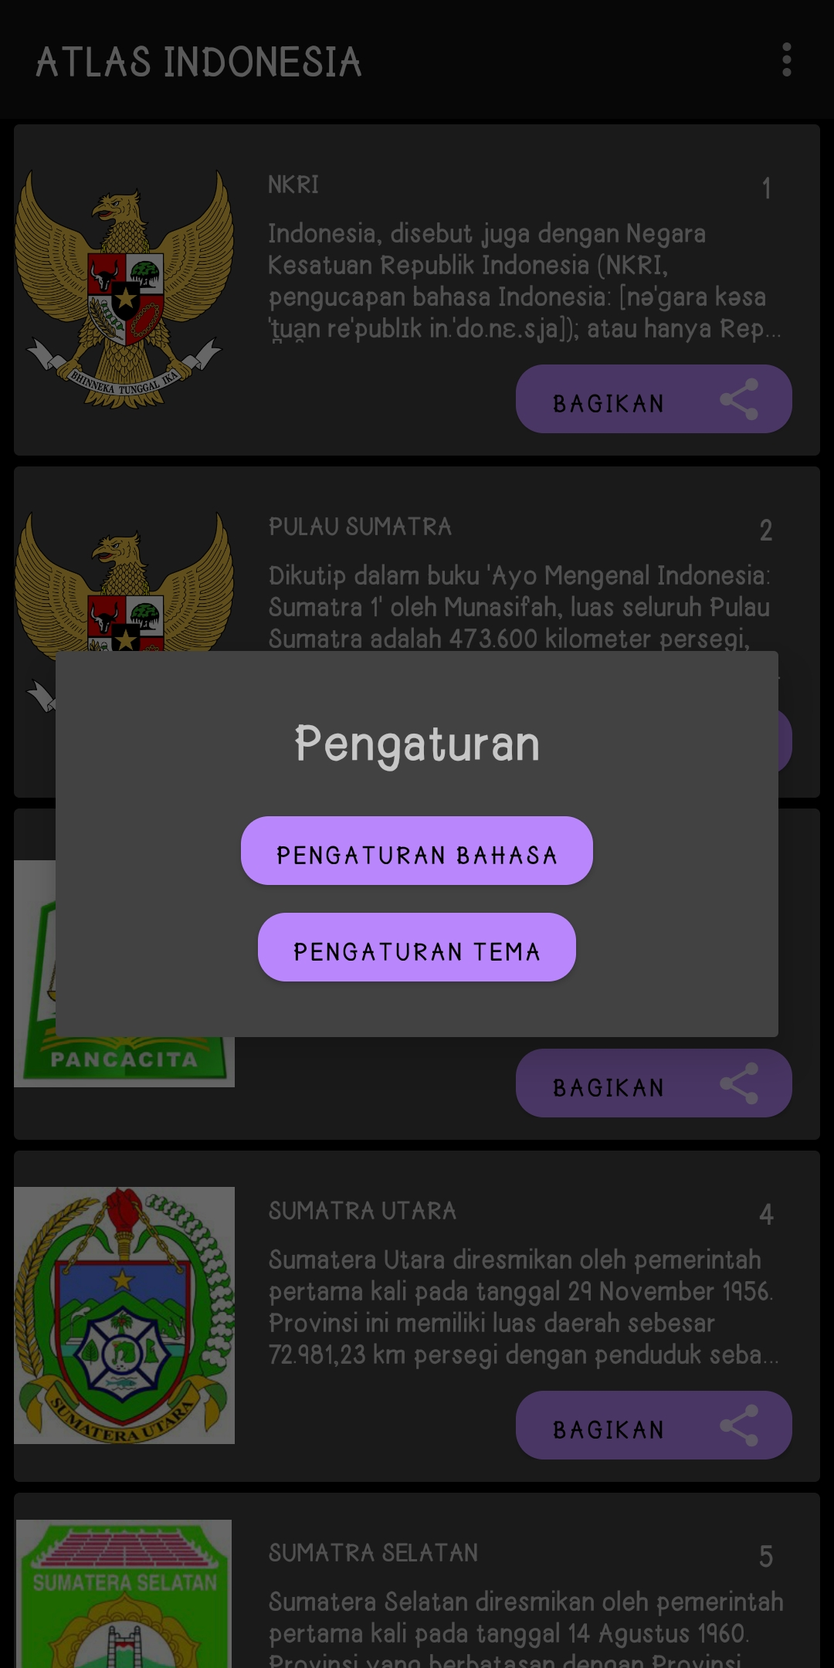
ATLAS INDONESIA SCREEN BEFORE MIGRATE TO COMPOSE UI

Slide 22
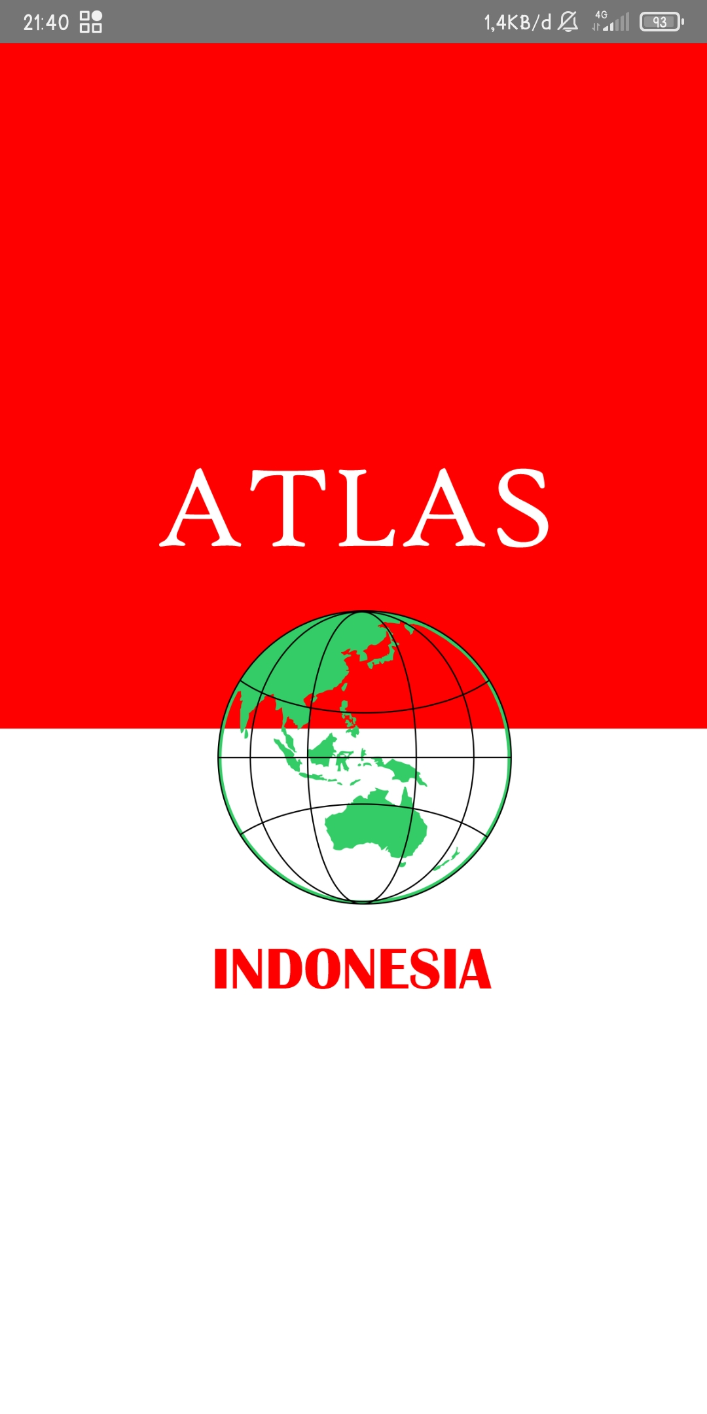
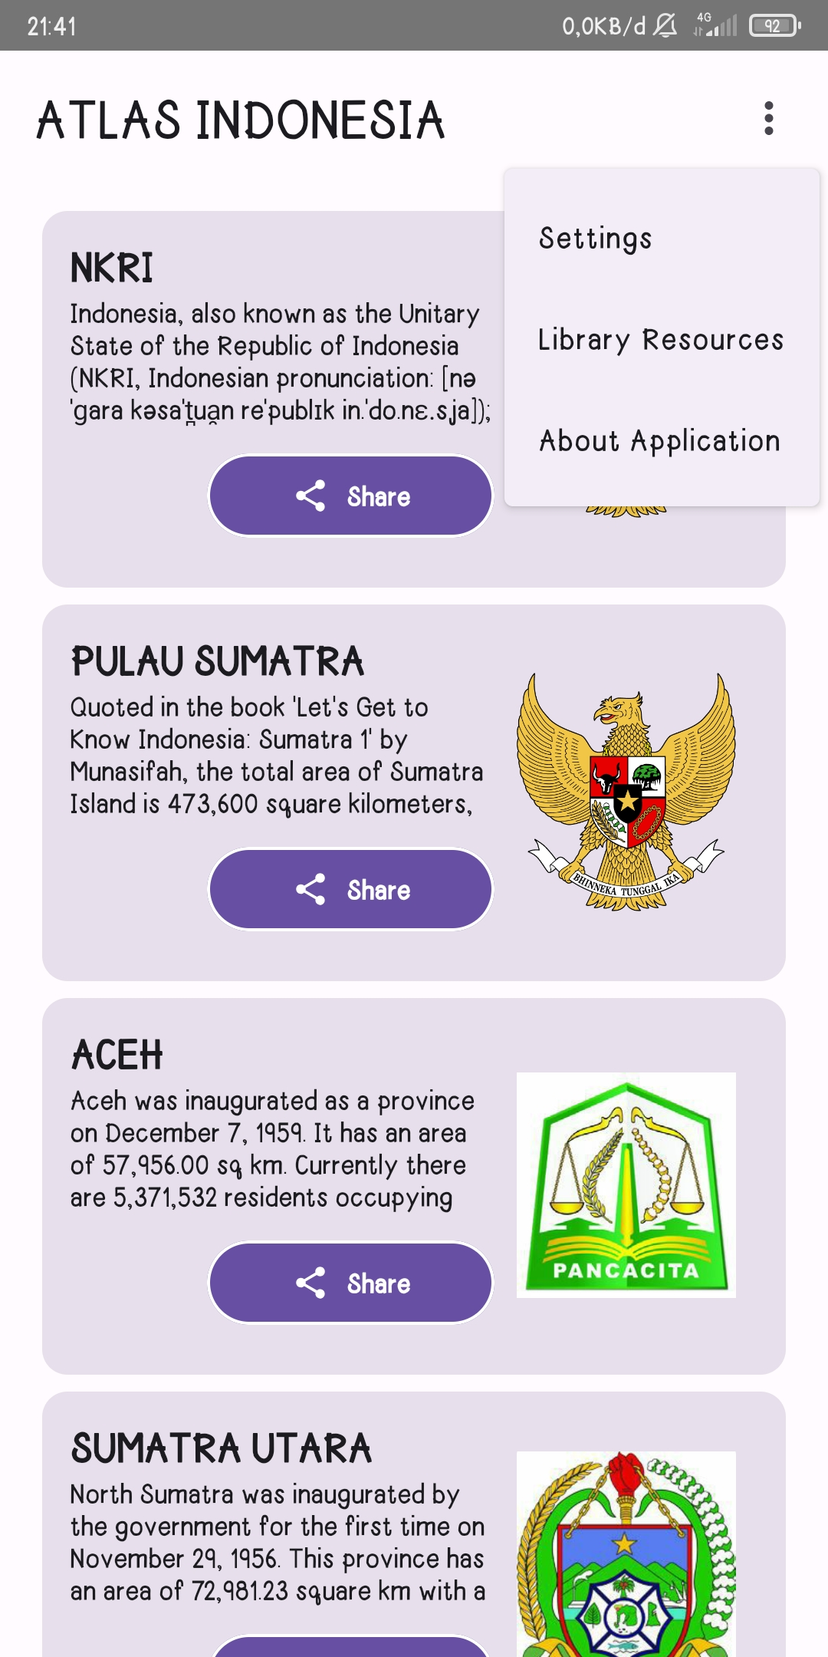
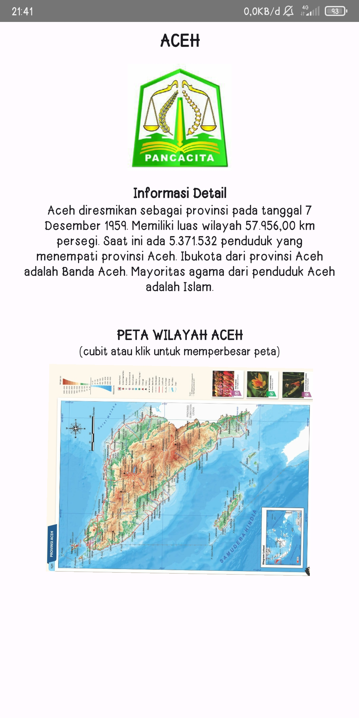
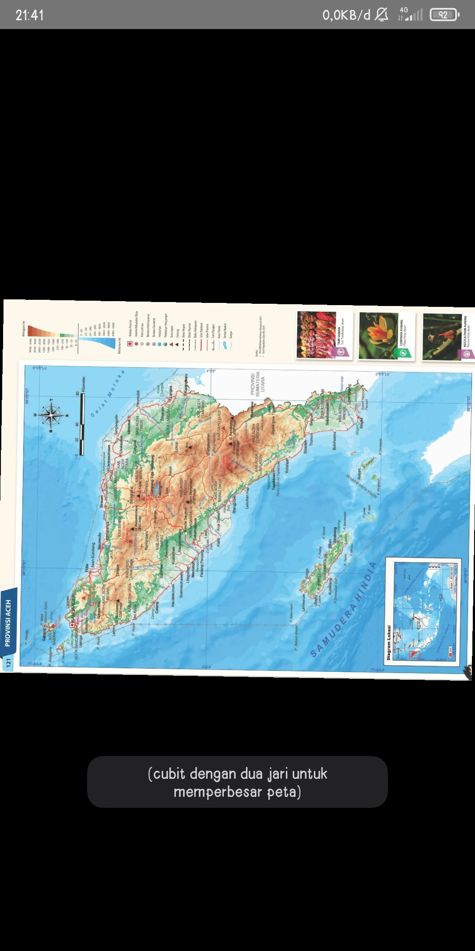
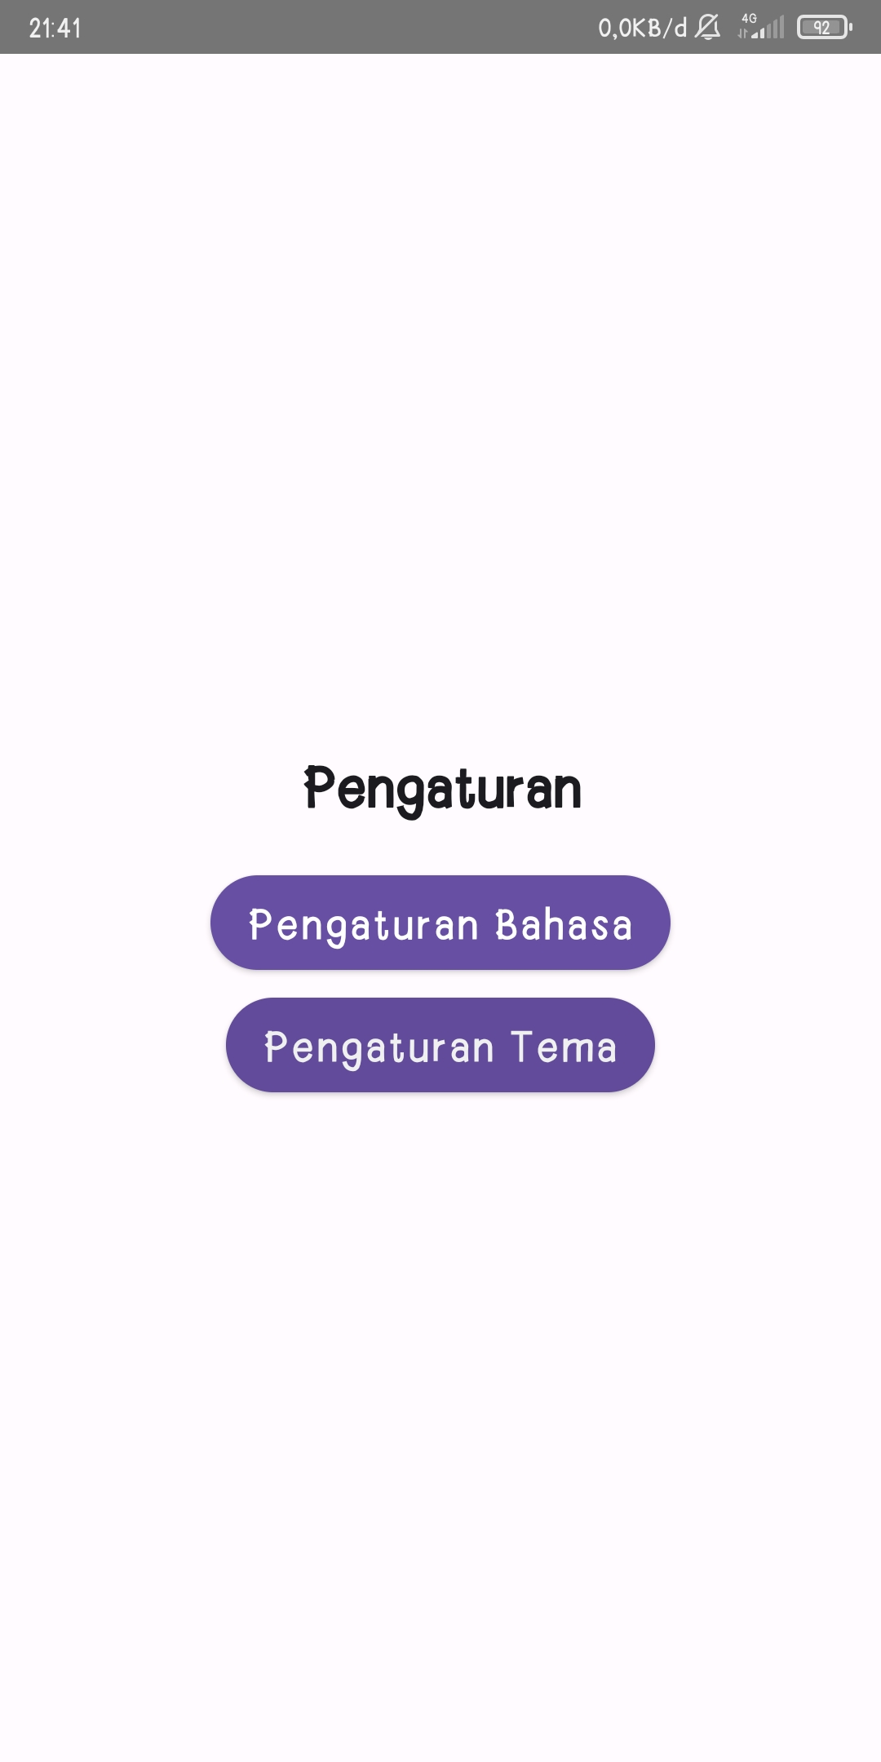
ATLAS INDONESIA SCREEN AFTER MIGRATE TO COMPOSE UI

Slide 23
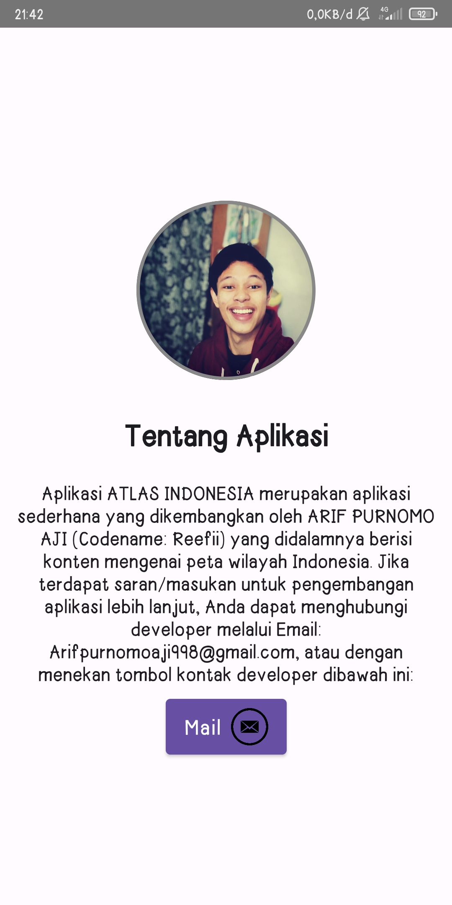
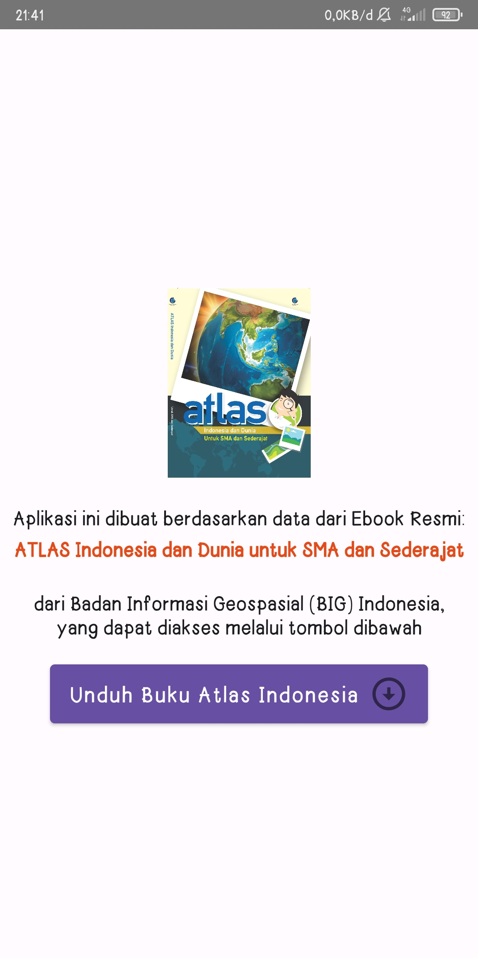
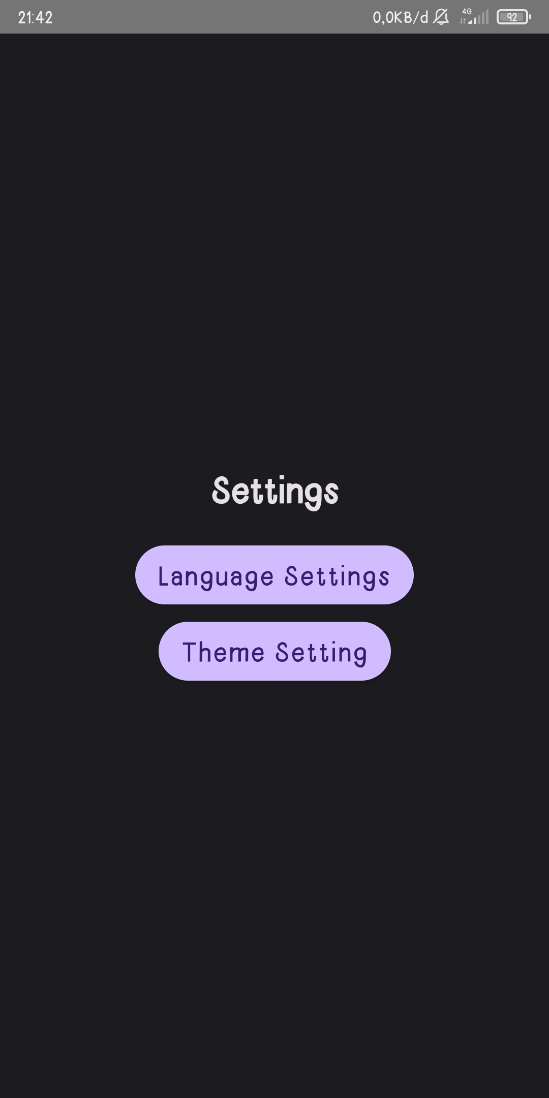
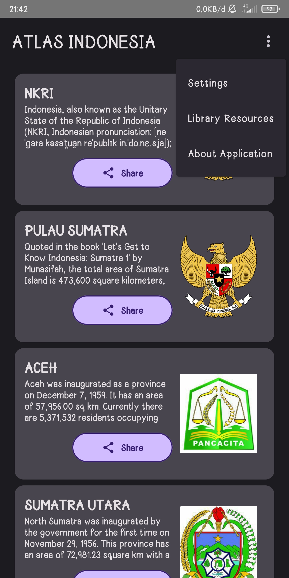
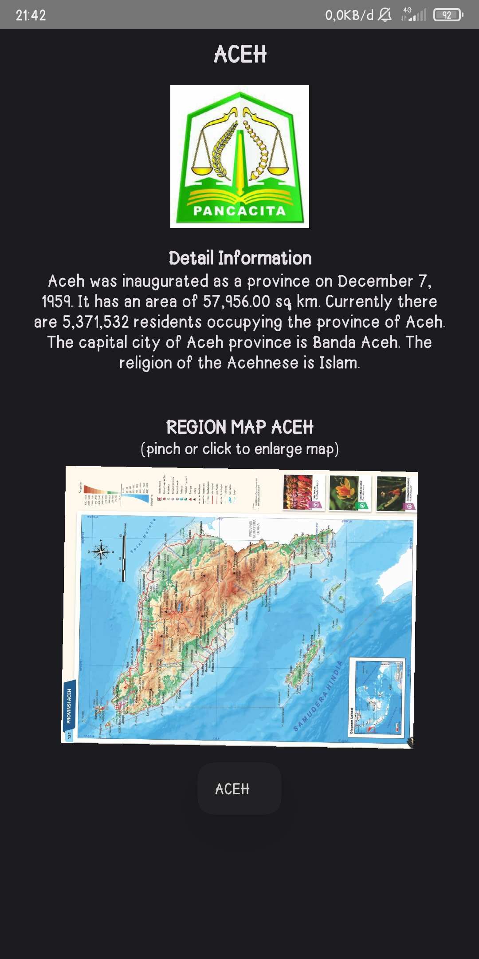
ATLAS INDONESIA SCREEN AFTER MIGRATE TO COMPOSE UI

Slide 24
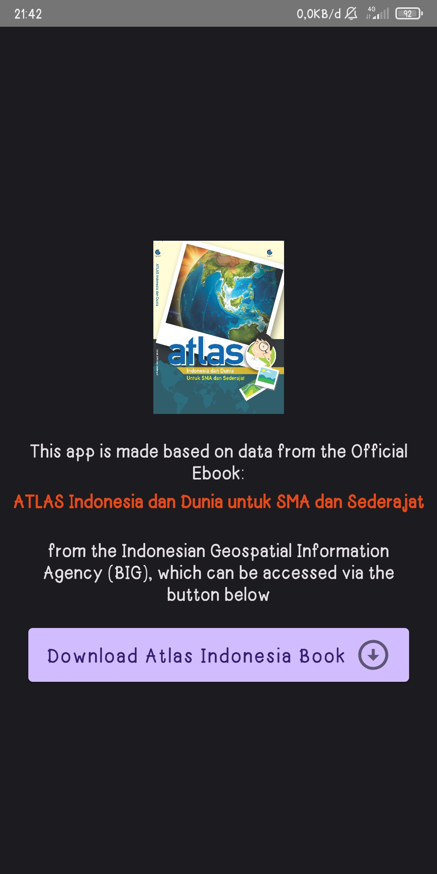
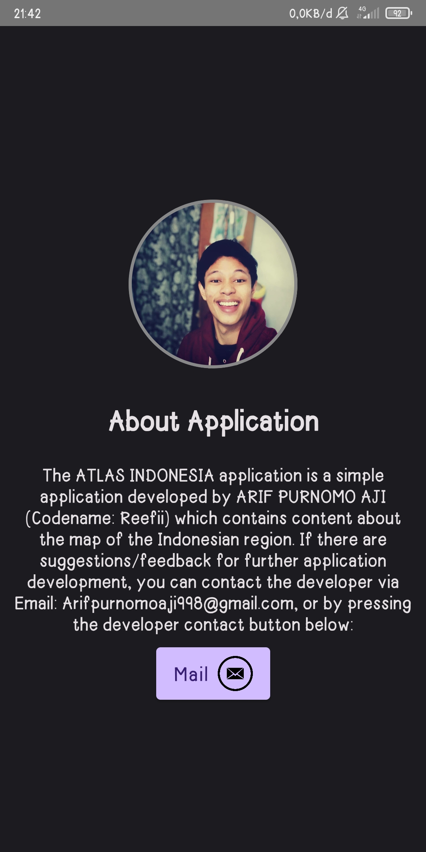
ATLAS INDONESIA SCREEN AFTER MIGRATE TO COMPOSE UI

Slide 25
THANKS.
ARIF PURNOMO AJI . REEFII
DICODING
Compose Champion Indonesia 2023:
Compose Migration Champion Challenge

